Slide 1
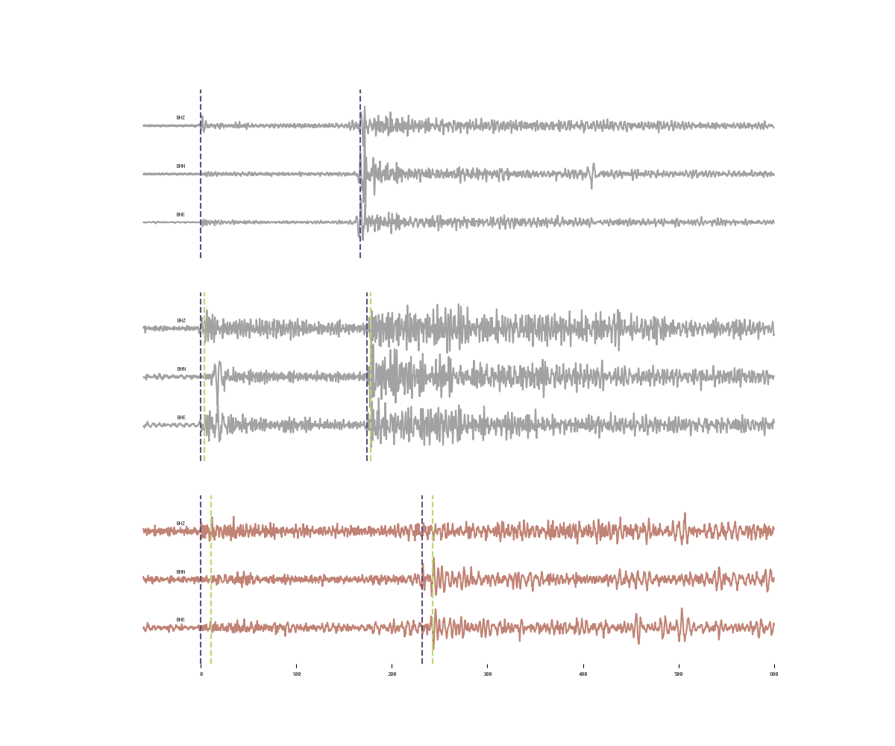


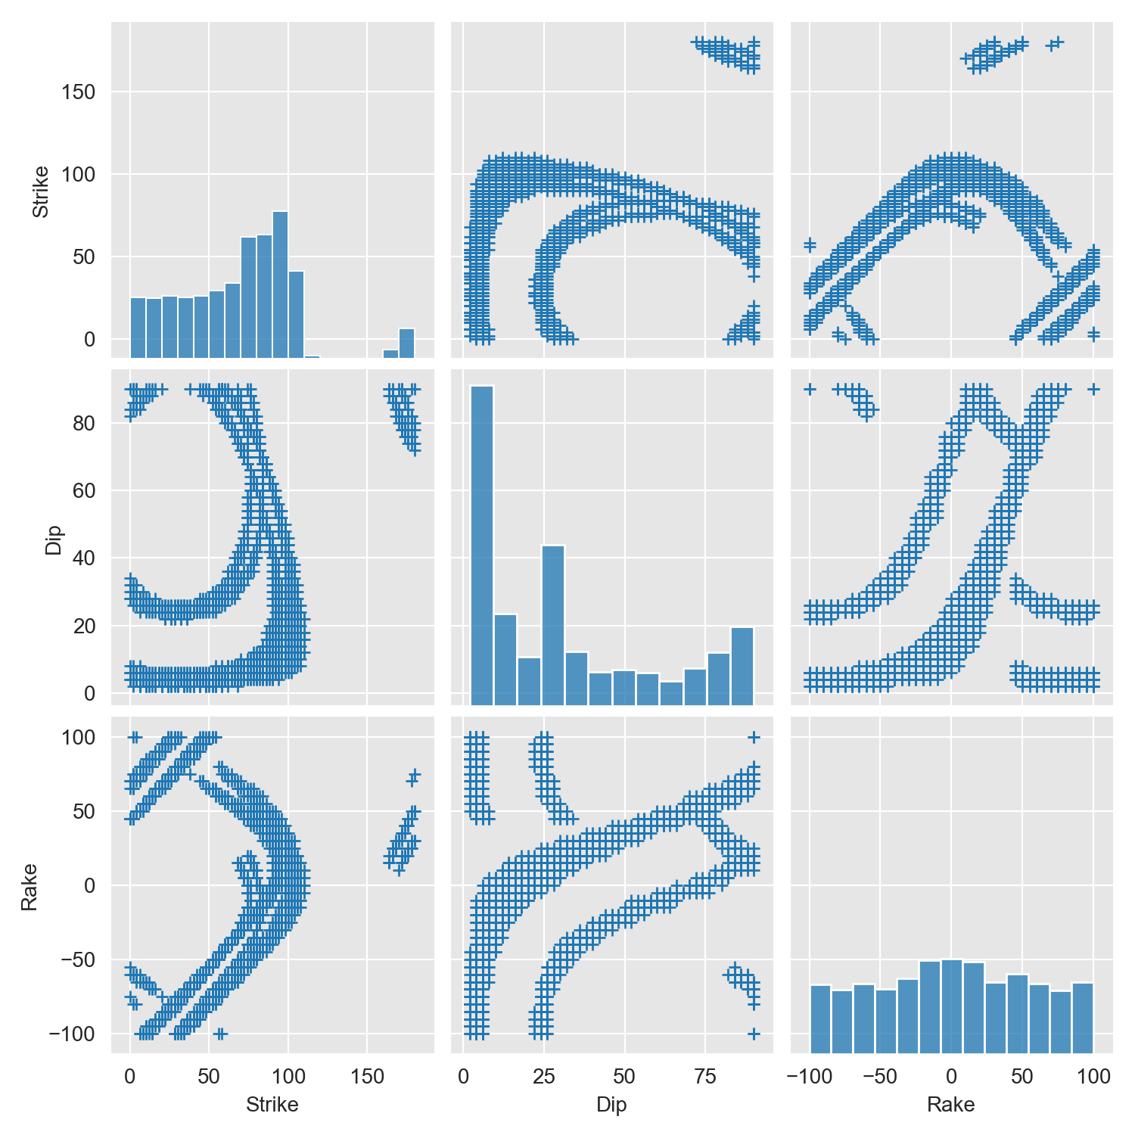







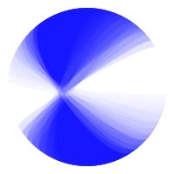
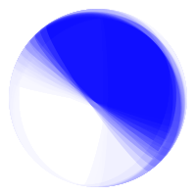



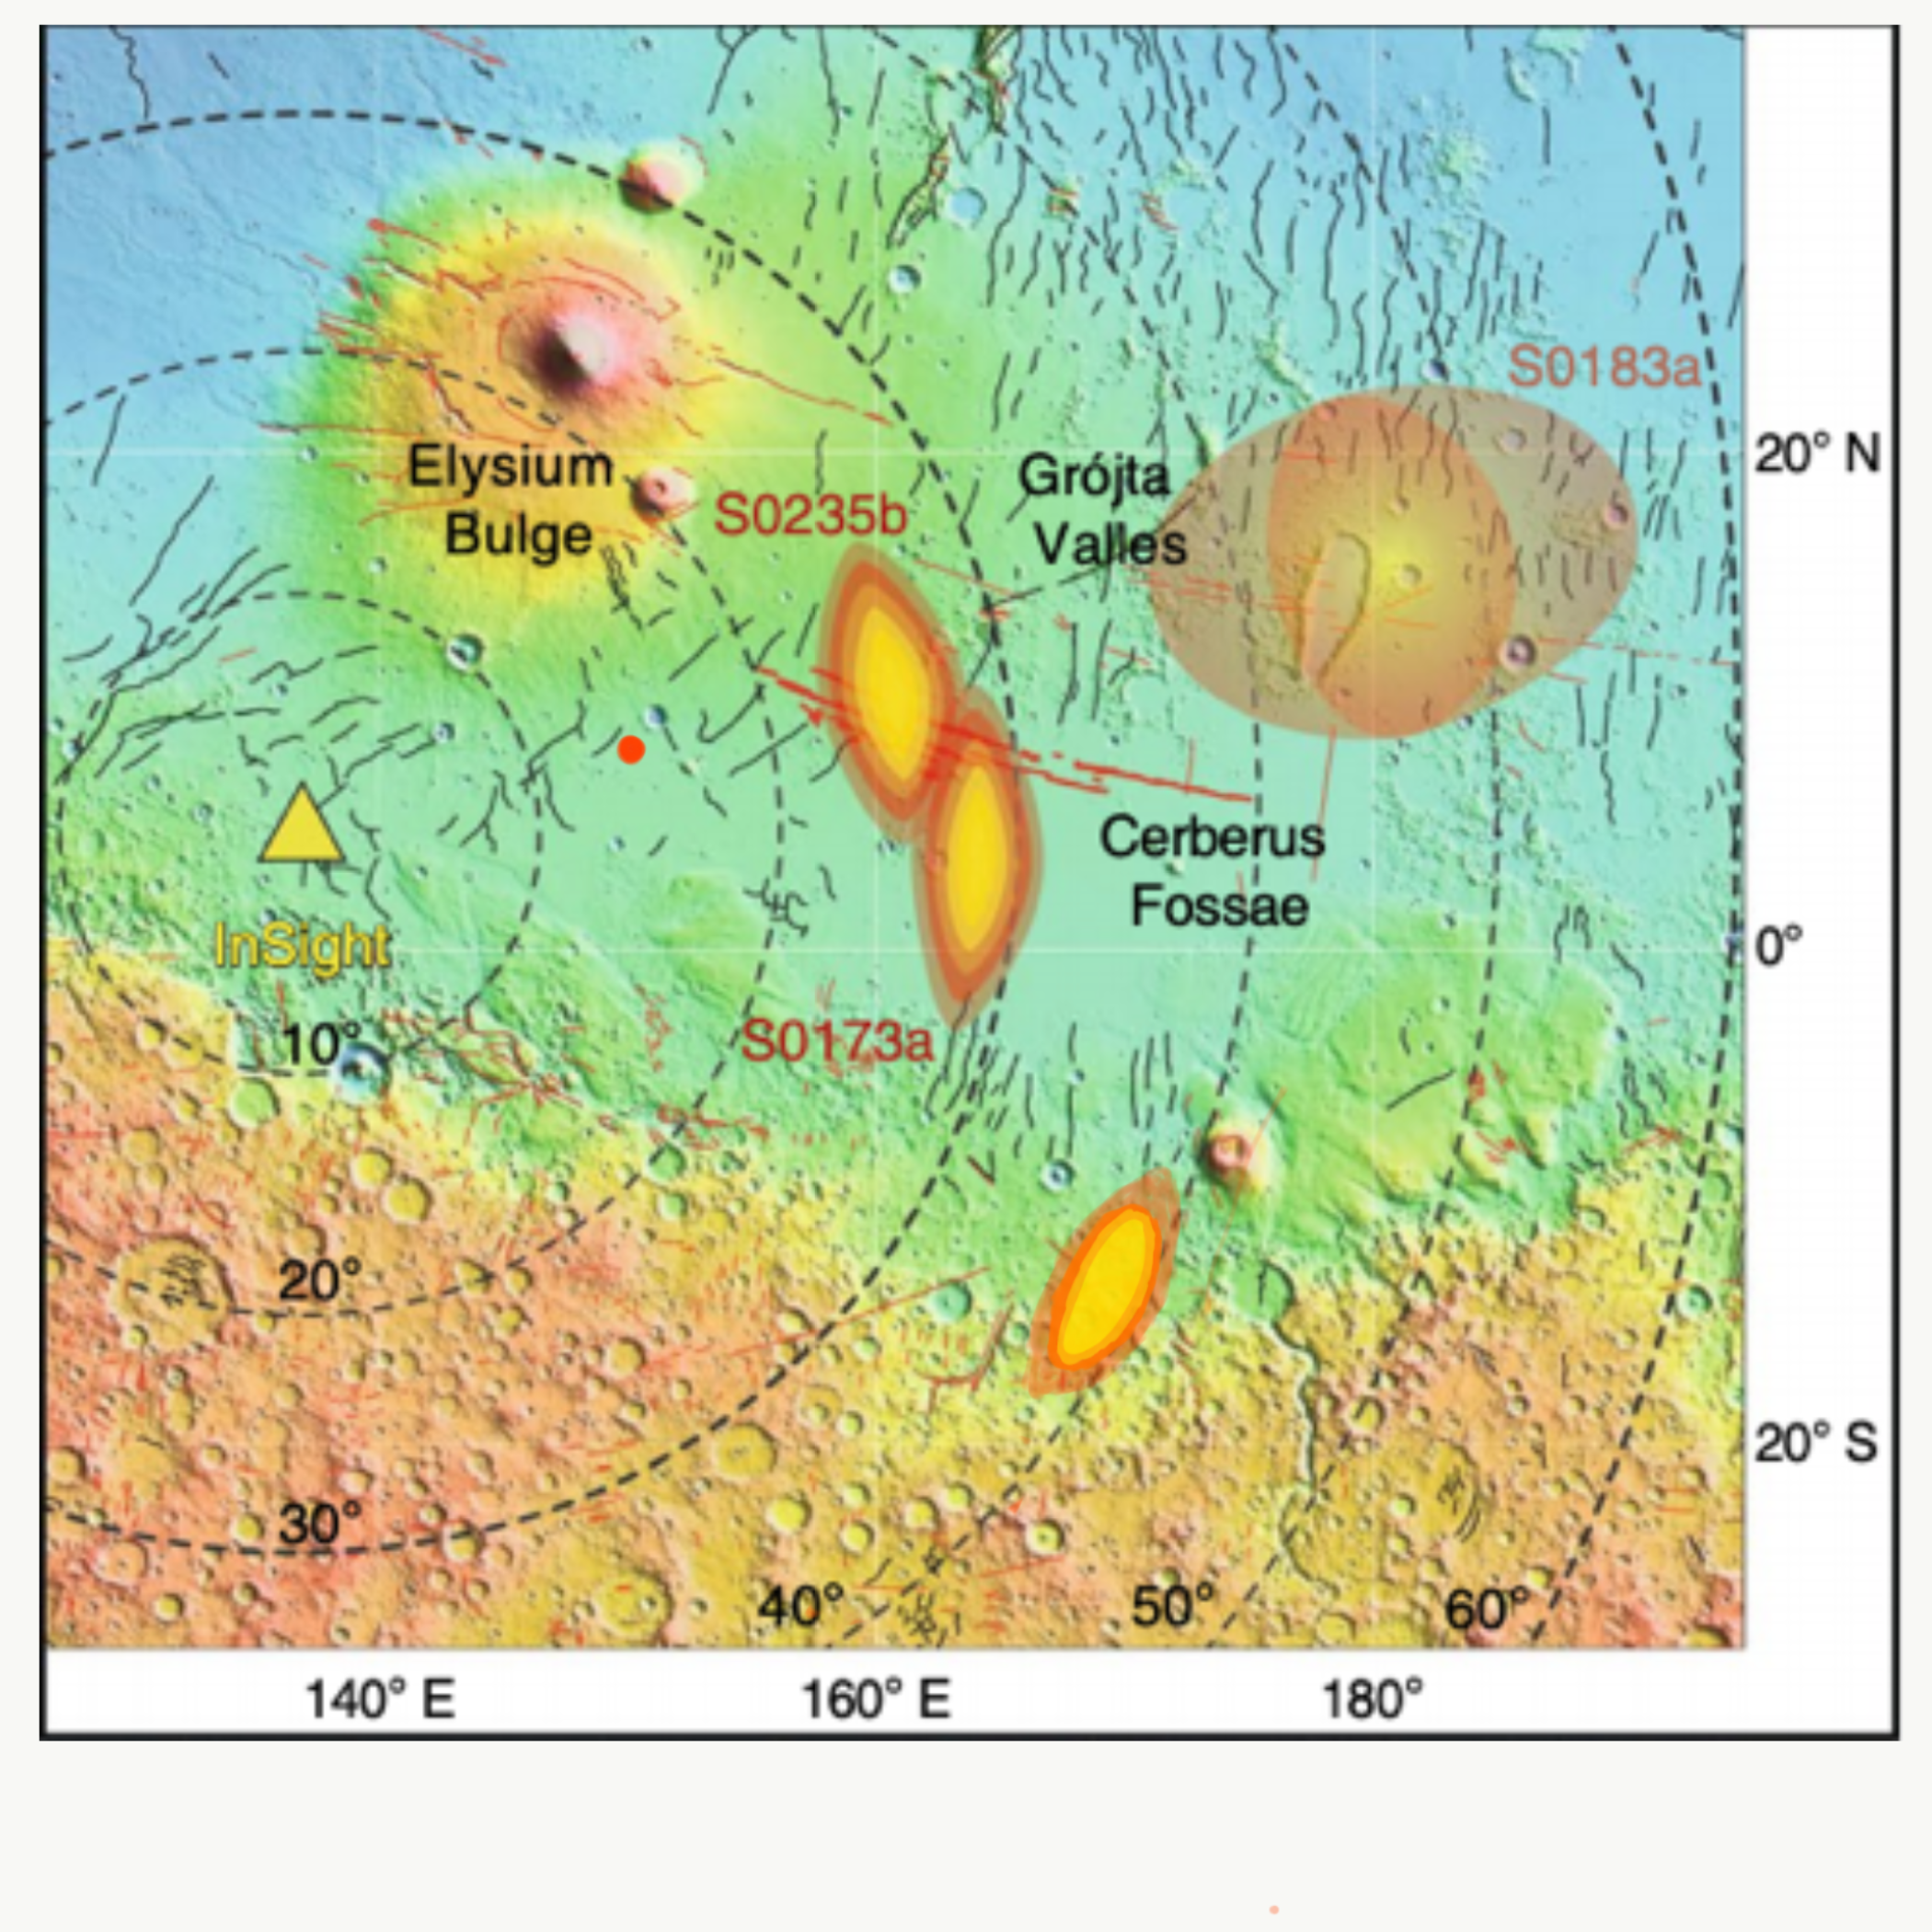

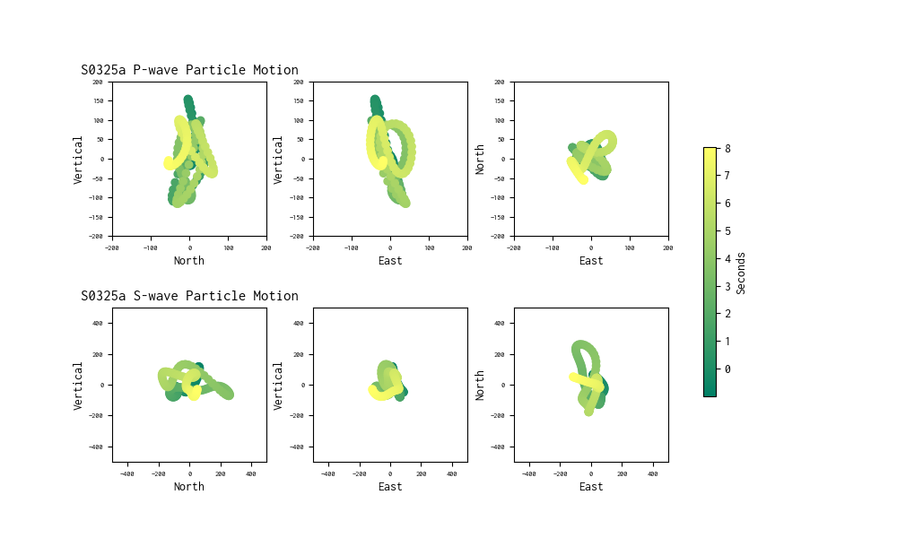
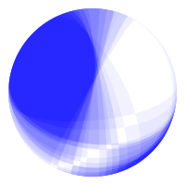


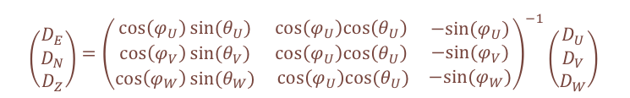
Using Data from
InSight to Locate and Explain Marsquakes
Collecting and analyzing data from IRIS Webservices
Investigating possible double-couple mechanisms
The instrument of interest for this project is the very broadband (VBB) seismometer, which is a part of the seismometer package, Seismic Experiment for Internal Structure (SEIS). The waveform data was downloaded directly from the Incorporated Research Institutions for Seismology (IRIS) database web service using the python package ObsPy.
Mars’ crust is composed of a single tectonic plate and therefore intraplate tectonics, such as faulting, and impacts are expected to be the major contributors to the seismicity of the planet^{2,3}. The lander is located about 1600km west of the Cerberus Fossae region, which is hypothesized to be an active tectonic structure and a major contributor to Mars’ seismicity^{4,5}.
Strike-Slip
Maddy Sita¹ & Suzan van der Lee²
S0173a and S0235b were both found to fall in the Cerberus Fossae region while the epicenter of S0325a is estimated to be near the boundary between the southern highland and the northern lowlands⁵. Our proposed faulting mechanisms shown below incorporated the information about these regions in our investigation.
[
¹ University of Virginia, ² Northwestern University
$$\left({D_{E} \atop \begin{aligned}D_{N} \\ D_{Z}\end{aligned}}\right)={\left(\begin{matrix}\cos\left(φ_{U}\right)sin⁡(θ_{U}) & \cos\left(φ_{U}\right)cos\left(θ_{U}\right) \\ \begin{aligned}\cos\left(φ_{V}\right)sin⁡(θ_{V}) \\ \cos\left(φ_{W}\right)sin⁡(θ_{W})\end{aligned} & \begin{aligned}\cos\left(φ_{U}\right)cos\left(θ_{U}\right) \\ cos⁡\left(φ_{U}\right)cos(θ_{U})\end{aligned} \end{matrix}\begin{matrix}−sin⁡(φ_{U}) \\ −sin⁡(φ_{V}) \\ −sin⁡(φ_{W})\end{matrix}\right)}^{−1}\left({D_{U} \atop \begin{aligned}D_{V} \\ D_{W}\end{aligned}}\right)$$
Using this equation, we reoriented the data such that each data stream pointed in the north, east and vertical direction before analysis¹.
Event: | Distance: | Back Azimuth: | Mechanism Types: | Fault Planes:
S0173a | 29° | 90° | Strike-Slip & Normal
S0173ab | - | 86° | Strike-Slip, Normal & Reverse
S0235b | 27.5° | 74° | Vertical Dip-Slip
S0235bi | 15° | - | Strike-Slip & Vertical Dip-Slip
S0325a | 38.5° | 123° | Vertical Dip-Slip
S0325ab | - | 139° | Strike-Slip
[
[
Normal
Reverse
S0235b
Grid Search
Using a modified version of the Gudkova model and an estimated source depth of 35km, we began modeling the SV, SH and P amplitudes that resulted from a range of double-couple focal mechanisms⁶.
A grid search was then performed over a range of strike, dip and rake combinations to determine which could reproduce the observed P, SH, and SV amplitudes. The best fitting fault plane orientation is shown in Figure 3 adapted from Giardini et al. (2020)⁵.
UTC2019-07-26T12:19:19
S0173a
Locating Marsquakes with a single detector
UTC2019-05-23T02:22:59
Using our observed difference in arrival time between the P and S wave, we then estimated the distance to the epicenter using travel time plots created from the previously published velocity models⁶. The back azimuth was calculated by rotating the three data streams to minimize the energy on the transverse component⁷. This provided an optimal arrival angle of the P-wave energy.
S0235bi
Particle Motion
We looked at the particle motion caused by the arrival of the P and S wave to estimate the direction, relative to the lander, from which the signals originated.
This particle motion shows the apparent “movement” of the event over time from the south-east to the north-east. It is possible that not all of the energy in this time window is purely
P-wave energy.
S0325a
S0325a
UTC2019-10-26T06:58:58
Figure 1. All three seismograms are provided for each event after being rotated to the east, north and vertical direction, plotted relative to the initial arrival of a P-wave at time 0. There is a clear P and S wave arrival for each event with the S0173a For S0325a and S0325ab the P-wave arrived at 06:58:57 UTC and 06:59:08 UTC and the S-wave arrived at 07:02:49 UTC and 07:03:00 UTC respectively
Figure 2. S0325a begins 1 second before the reported waveform arrival times and ends 8 seconds after and shows the beginning of S0325ab, whose P-wave arrives 11 seconds after S0325a.
Figure 3. The figure was adopted from Giardini et al (2020) to include the new event S0325a at an approximate latitude and longitude of -15°N, 168°E as well as the possible fault planes.
This material is based upon work supported by the National Science Foundation under Grant No. AST-1757792, a Research Experiences for Undergraduates (REU) grant awarded to CIERA at Northwestern University. Any opinions, findings, and conclusions or recommendations expressed in this material are those of the author(s) and do not necessarily reflect the views of the National Science Foundation.
1. Suemoto, Y., Ikeda, T., & Tsuji, T. (2020). Temporal variation and frequency dependence of seismic ambient noise on Mars from polarization analysis. Geophysical Research Letters, 47, e2020GL087123. https://doi.org/10.1029/2020GL087123
2. Lognonné, P., Banerdt, W.B., Giardini, D. et al. SEIS: Insight’s Seismic Experiment for Internal Structure of Mars. Space Sci Rev 215, 12 (2019). https://doi.org/10.1007/s11214-018-0574-6
3. Banerdt, W.B., Smrekar, S.E., Banfield, D. et al. Initial results from the InSight mission on Mars. Nat. Geosci. 13, 183–189 (2020). https://doi.org/10.1038/s41561-020-0544-y
4. Taylor, J., Teanby, N. A., and Wookey, J. (2013), Estimates of seismic activity in the Cerberus Fossae region of Mars, J. Geophys. Res. Planets, 118, 2570– 2581, doi:10.1002/2013JE004469.
5. Giardini, D., Lognonné, P., Banerdt, W.B. et al. The seismicity of Mars. Nat. Geosci. 13, 205–212 (2020). https://doi-org.proxy01.its.virginia.edu/10.1038/s41561-020-0539-8
6. J. F. Clinton, D. Giardini, P. Lognonné, B. Banerdt, M. van Driel, M. Drilleau, N. Murdoch, M. Panning, R. Garcia, D. Mimoun, M. Golombek, J. Tromp, R. Weber, M. Böse, S. Ceylan, I. Daubar, B. Kenda, A. Khan, L. Perrin, A. Spiga; Preparing for InSight: An Invitation to Participate in a Blind Test for Martian Seismicity. Seismological Research Letters 2017;; 88 (5): 1290–1302. doi: https://doi.org/10.1785/0220170094
7. Olugobji, T., Moser, E. Sesmic Waveform Polarization Analysis, ROSES 2020, organized by F. Dannemann & S. van der Lee, https://connect.agu.org/seismology/roses2021

Slide 2
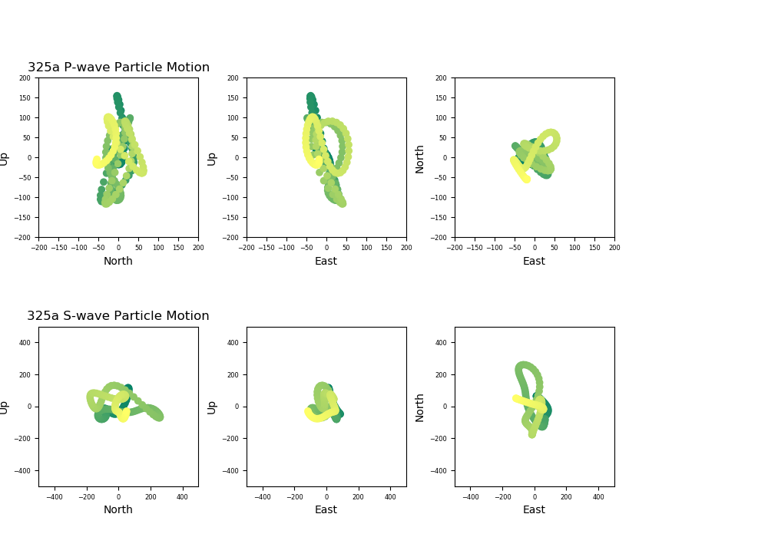
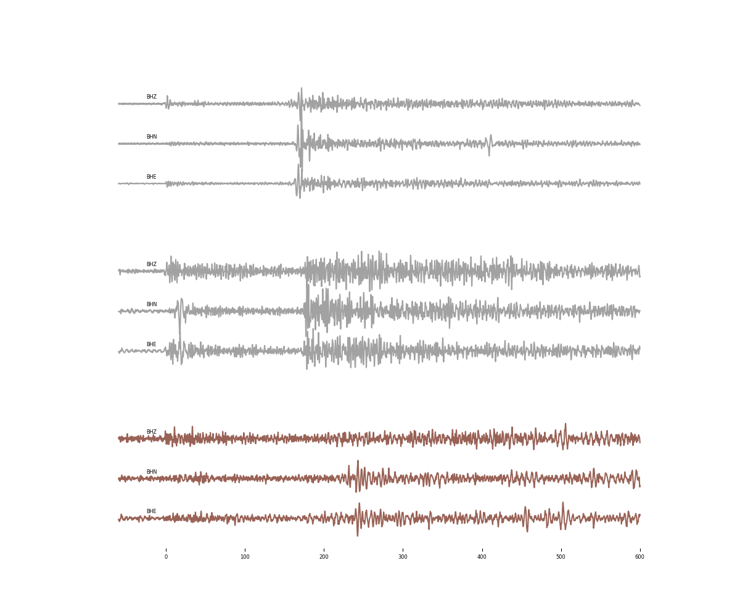
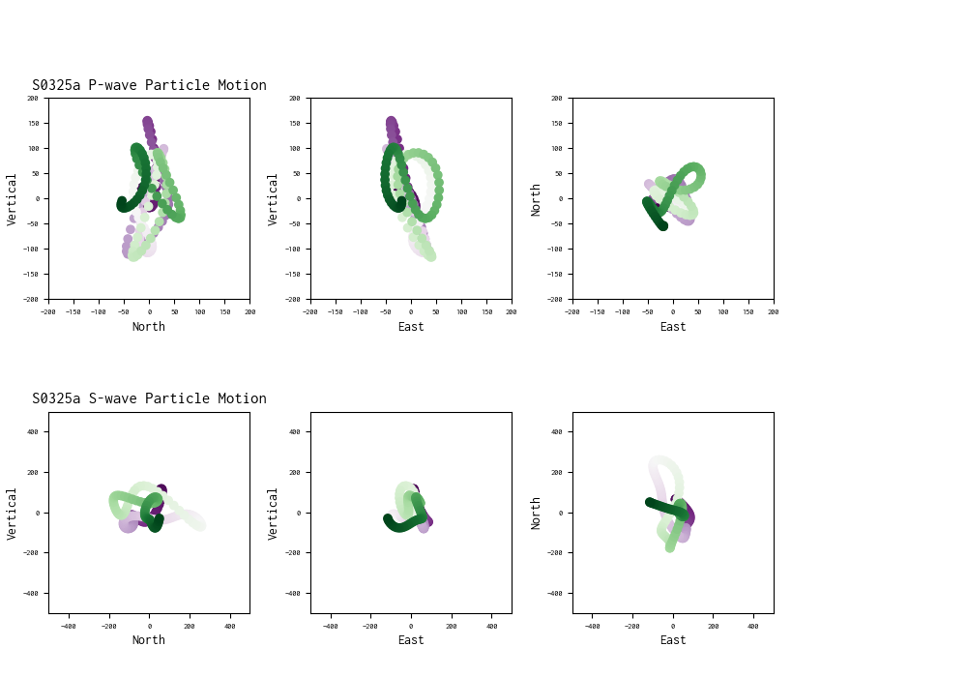
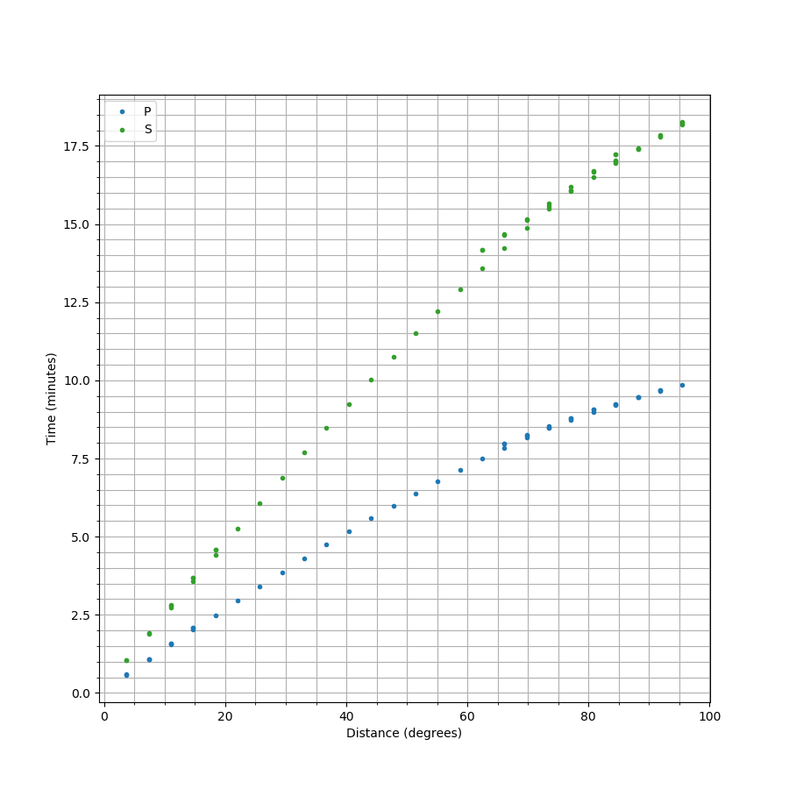
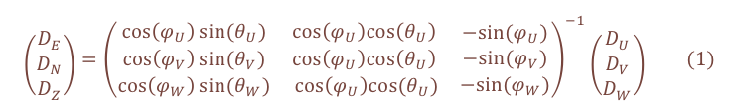
Using Data from
InSight to Explain and Locate Marsquakes
Everything we thought we knew about Marsquakes
Fig 1. This figure comes from NASA’s Bruce Murray Space Image Library
Mars’ crust is composed of a single tectonic plate and therefore intraplate tectonics, such as faulting, and impacts are expected to be the major contributors to the seismicity of the planet^{1,2}.
The lander is located about 1600km west of the Cerberus Fossae region, which is hypothesized to be an active tectonic structure and a major contributor to Mars’ seismicity^{3,4}.
Maddy Sita¹ & Suzan van der Lee²
Strike-slip
S0235b
UTC2019-07-26T12:19:19
Collecting and analyzing data from IRIS Webservices
The instrument of interest for this project is the very broadband (VBB) seismometer, which is a part of the seismometer package, Seismic Experiment for Internal Structure (SEIS). The waveform data was downloaded directly from the Incorporated Research Institutions for Seismology (IRIS) database web service exploited by a function of the python package ObsPy. Using the equation below, we orientated the data such that each data stream now pointed in the north, east and vertical direction.
¹ University of Virginia, ² Northwestern University
S0173a
Normal
Reverse
UTC2019-05-23T02:22:59
$$\left({D_{E} \atop \begin{aligned}D_{N} \\ D_{Z}\end{aligned}}\right)={\left(\begin{matrix}\cos\left(φ_{U}\right)sin⁡(θ_{U}) & \cos\left(φ_{U}\right)cos\left(θ_{U}\right) \\ \begin{aligned}\cos\left(φ_{V}\right)sin⁡(θ_{V}) \\ \cos\left(φ_{W}\right)sin⁡(θ_{W})\end{aligned} & \begin{aligned}\cos\left(φ_{U}\right)cos\left(θ_{U}\right) \\ cos⁡\left(φ_{U}\right)cos(θ_{U})\end{aligned} \end{matrix}\begin{matrix}−sin⁡(φ_{U}) \\ −sin⁡(φ_{V}) \\ −sin⁡(φ_{W})\end{matrix}\right)}^{−1}\left({D_{U} \atop \begin{aligned}D_{V} \\ D_{W}\end{aligned}}\right) (1)$$
S0325a
Locating Marsquakes with a single detector
UTC2019-10-26T06:58:58
After analyzing the candidates in different frequency spaces, we identified one event as likely having seismic origin in addition to our two previously stated references. The event, now known as S0325a, occurred on 26 October 19 with the P-wave arriving at 06:58:58 UTC and the S-wave arriving at 07:02:56 UTC.
Fig 2. This figure was adopted from Giardini et al. 2020 to include the new event.⁵
Particle Motion
This particle motion seems to show a movement of the direction of the event over time from the south-east to the north-east. It is possible that not all of the energy in this time window is P-wave energy.
Based on orbital imagery Cerberus Fossae is predicted to be an active graben system⁴. It is hypothesized that majority of the faults in this system will be reverse faults due to the global contraction of the planet^{1.}
S0325a
The three possible types of source mechanism is a normal, reverse of strike-slip fault.
Each can be characterized by a unique set of strike, dip and rake angles.
Possible Ray Paths
of Seismic Waves
Event Name: | Distance: | Back Azimuth: | Source Mechanism
S0173a | 29° | 91° | Likely shear factor
S0235b | 27.5° | 74° | Likely shear factor
S0325a | 38.5° | 123° | Likely shear factor
LVL?
Time Travel Plot for Gudkova Model
P
What does this tell us about Mars and the future of planetary sciences?
S
3:58
Based on the estimated location of S0325a, it can be concluded that the event most likely did not originate from Cerberus Fossae. However, there is evidence of faulting in this new area as seen by orbital imagery⁵. The particle motion suggests a moving source mechanism but dust devils would not be strong enough to produce low-frequency events.
By also gaining a better understanding of seismology using a single instrument, we can begin to develop better technology and data processing techniques. These updated methods can then be used to investigate the interior of other small bodies in our solar system, like Europa or Titan.
Core
Mantle
Crust
This material is based upon work supported by the National Science Foundation under Grant No. AST-1757792, a Research Experiences for Undergraduates (REU) grant awarded to CIERA at Northwestern University. Any opinions, findings, and conclusions or recommendations expressed in this material are those of the author(s) and do not necessarily reflect the views of the National Science Foundation.
1. Clinton, J., Giardini, D., Böse, M. et al. The Marsquake Service: Securing Daily Analysis of SEIS Data and Building the Martian Seismicity Catalogue for InSight. Space Sci Rev 214, 133 (2018). https://doi.org/10.1007/s11214-018-0567-5
2. Lognonné, P., Banerdt, W.B., Giardini, D. et al. SEIS: Insight’s Seismic Experiment for Internal Structure of Mars. Space Sci Rev 215, 12 (2019). https://doi.org/10.1007/s11214-018-0574-6
3. Banerdt, W.B., Smrekar, S.E., Banfield, D. et al. Initial results from the InSight mission on Mars. Nat. Geosci. 13, 183–189 (2020). https://doi.org/10.1038/s41561-020-0544-y
4. Taylor, J., Teanby, N. A., and Wookey, J. (2013), Estimates of seismic activity in the Cerberus Fossae region of Mars, J. Geophys. Res. Planets, 118, 2570– 2581, doi:10.1002/2013JE004469.
5. Giardini, D., Lognonné, P., Banerdt, W.B. et al. The seismicity of Mars. Nat. Geosci. 13, 205–212 (2020). https://doi-org.proxy01.its.virginia.edu/10.1038/s41561-020-0539-8

Slide 3
#B8D96E
#654E78
#A2A2A3

